Slide 1

Machine Learning
ICT-4261
By-
Dr. Jesmin Akhter
Professor
Institute of Information Technology
Jahangirnagar University

Slide 2
Contents
Naive Bayes
Support Vector Machines
The course will mainly cover the following topics:
A Gentle Introduction to Machine Learning
Linear Regression
Logistic Regression
Naive Bayes
Support Vector Machines
Decision Trees and Ensemble Learning
Clustering Fundamentals
Hierarchical Clustering
Neural Networks and Deep Learning
Unsupervised Learning

Slide 3
Outline
Logistic Regression
Logistic regression
Sigmoid Function
Logistic Regression Equation and Assumptions
Loss Function
Derivation of Cost Function
Notes:
https://www.javatpoint.com/regression-analysis-in-machine-learning

Slide 4
Logistic regression
Logistic regression is a supervised machine learning algorithm that is commonly used in binary classification problems where the outcome variable reveals either of the two categories: yes/no, 0/1, or true/false.
Logical regression analyzes the relationship between one or more independent variables and classifies data into discrete classes. It is extensively used in predictive modeling, where the model estimates the mathematical probability of whether an instance belongs to a specific category or not.
For example,
0 – represents a negative class;
1 – represents a positive class.
Logistic Regression is much similar to the Linear Regression except that how they are used. Linear Regression is used for solving Regression problems, whereas Logistic regression is used for solving the classification problems.
So despite its name, it's a classification algorithm

Slide 5
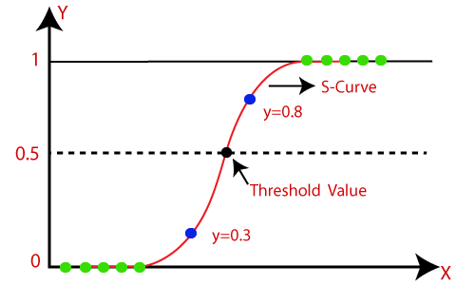
Logistic regression
In Logistic regression, instead of fitting a regression line, we fit an "S" shaped logistic function, which predicts two maximum values (0 or 1). Instead of giving the exact value as 0 and 1, it gives the probabilistic values which lie between 0 and 1.
The curve from the logistic function indicates the likelihood of something such as whether the cells are cancerous or not, a mouse is obese or not based on its weight, etc.
Logistic Regression is a significant machine learning algorithm because it has the ability to provide probabilities and classify new data using continuous and discrete datasets.
Logistic Regression can be used to classify the observations using different types of data and can easily determine the most effective variables used for the classification. The below image is showing the logistic function:
Notes:
https://www.javatpoint.com/logistic-regression-in-machine-learning

Slide 6
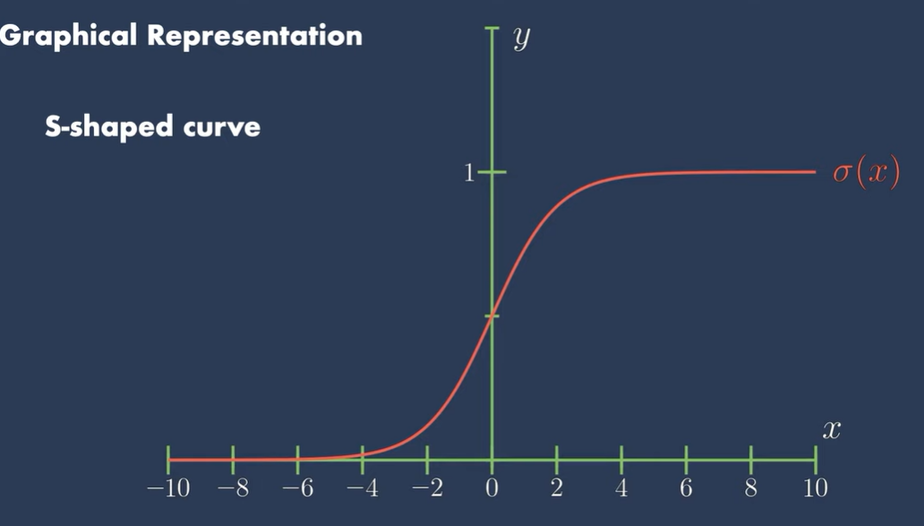
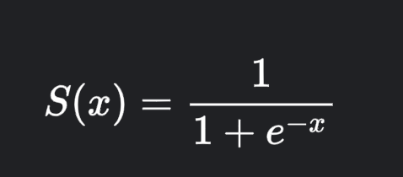
Sigmoid Function?
The sigmoid function, also known as the logistic function, is a mathematical curve that has an S-shaped or sigmoidal curve. It is defined as follows:
In this equation:
S(x) represents the output of the sigmoid function.
x is the input, which can take any real value.
e is the base of the natural logarithm, approximately equal to 2.71828.

Slide 7
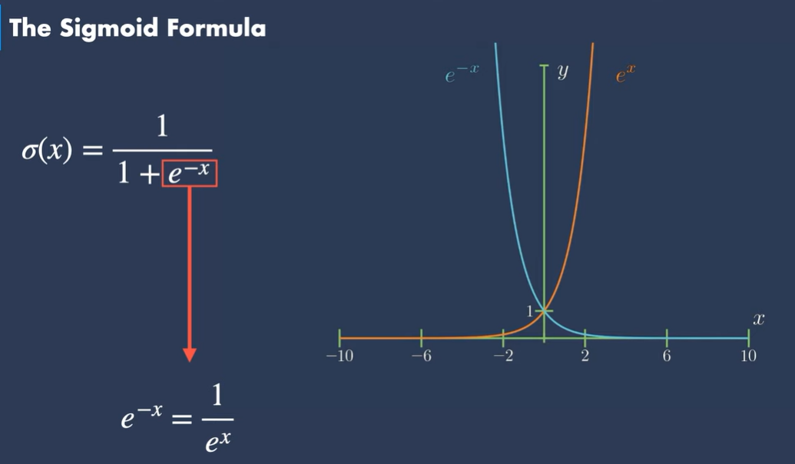
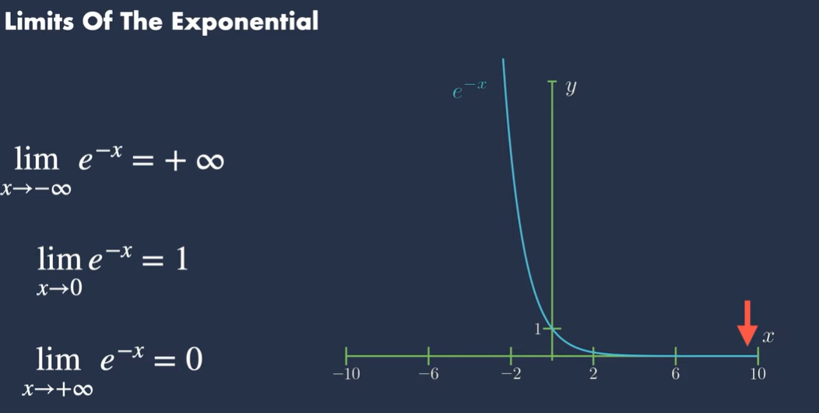
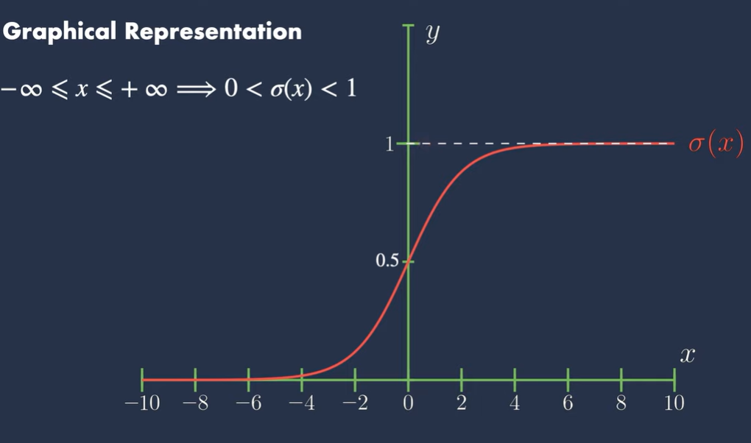
Sigmoid Function
The sigmoid function is used to map the predicted values to probabilities.
The sigmoid function takes any real number as input and outputs a value between 0 and 1. It approaches 0 as the input becomes negative and 1 as the input becomes positive. When the input is 0, the sigmoid function returns 0.5.
The value of the logistic regression must be between 0 and 1, which cannot go beyond this limit, so it forms a curve like the "S" form. The S-form curve is called the Sigmoid function or the logistic function.
In logistic regression, we use the concept of the threshold value, which defines the probability of either 0 or 1. Such as values above the threshold value tends to 1, and a value below the threshold values tends to 0.

Slide 8
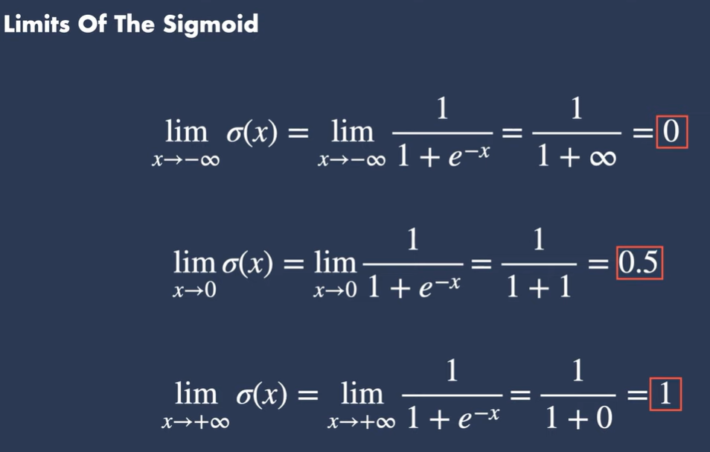
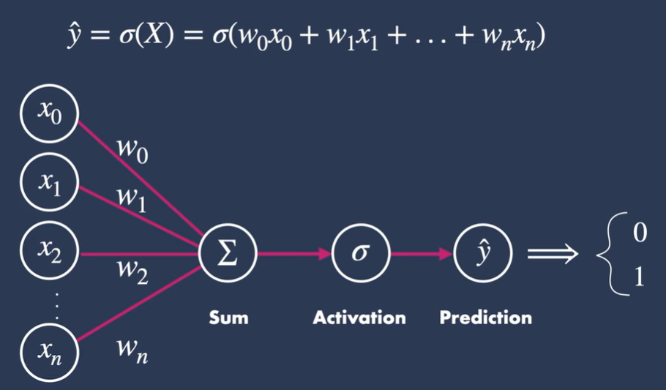

Slide 9




Logistic Regression Equation and Assumptions
How logistic regression squeezes the output of linear regression between 0 and 1?
Let’s start by mentioning the formula of logistic function:
The equation of the best fit line in linear regression is:
Let’s say instead of y we are taking probabilities (P).
But there is an issue here, the value of (P) will exceed 1 or go below 0 and we know that range of Probability is (0-1). To overcome this issue we take “odds” of P:
Odds can always be positive which means the range will always be (0,+∞ ). Odds are nothing but the ratio of the probability of success and probability of failure. Now the question comes out of so many other options to transform this why did we only take ‘odds’? Because odds are probably the easiest way to do this.

Slide 10

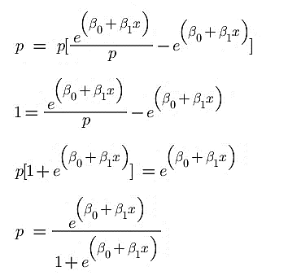
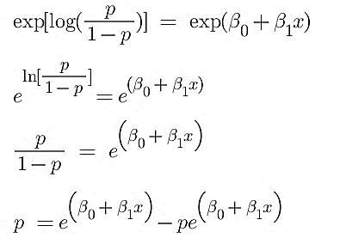
Logistic Regression Equation and Assumptions
The problem here is that the range is restricted and we don’t want a restricted range because if we do so then our correlation will decrease. By restricting the range we are actually decreasing the number of data points and of course, if we decrease our data points, our correlation will decrease. It is difficult to model a variable that has a restricted range. To control this we take the log of odds which has a range from (-∞,+∞).
Now we just want a function of P because we want to predict probability, not log of odds. To do so we will multiply by exponent on both sides and then solve for P.

Slide 11
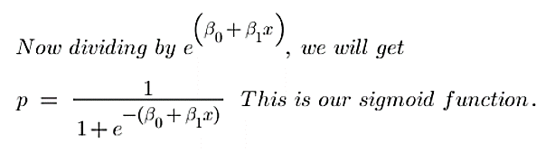
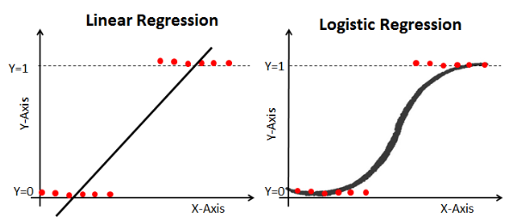
Logistic Regression Equation and Assumptions
here,
x = input value
P = predicted output
ꞵ0 = bias or intercept term
ꞵ₁ = coefficient for input (x)
The following equation represents logistic regression:
The above equation represents logistic regression. This equation is similar to linear regression, where the input values are combined linearly to predict an output value using weights or coefficient values. However, unlike linear regression, the output value modeled here is a binary value (0 or 1) rather than a numeric value
Thus Logistic regression squeezes a straight line into an S-curve with the help of a sigmoid function is as shown below.

Slide 12
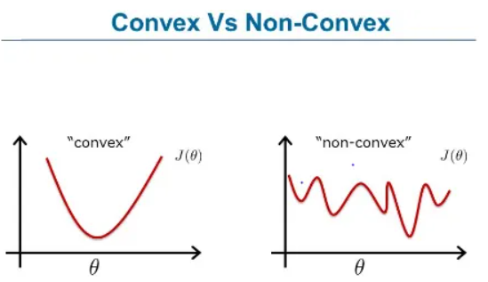
Loss Function
For Logistic Regression we can't use the same loss function as for Linear Regression because the Logistic Function (Sigmoid Function) will cause the output to be non-convex, which will cause many local optima.

Slide 13
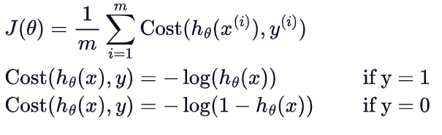
Loss Function
Instead, we will use the following loss function for logistic regression:
To make it easier to work with the loss function we can compress the two conditional cases into one equation:
Notice that when y is equal to 1 the second term will be zero and therefore will not affect the loss.
One the other hand if y is equal to 0 the first term will be zero and therefore will not affect the loss

Slide 14
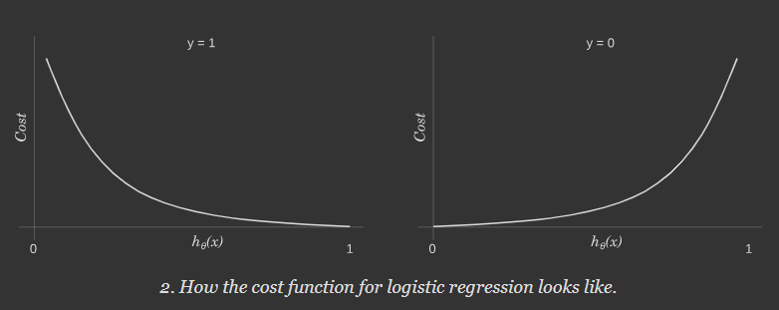
Simplifying the Loss Function
In case y=1, the output (i.e. the cost) approaches to 0 as hθ(x) approaches to 1. Conversely, the cost grows to infinity as hθ(x) approaches to 0. You can clearly see it in the plot of the left side. If the label is y=1 but the algorithm predicts hθ(x)=0, the outcome is completely wrong.
Conversely, the same intuition applies when y=0, depicted in the plot of the right side. Bigger penalties when the label is y=0 but the algorithm predicts hθ(x)=1.

Slide 15
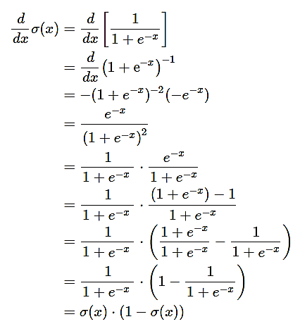
Derivation of Cost Function
Before we derive our cost function we’ll first find a derivative for our sigmoid function because it will be used in derivating the cost function.

Slide 16
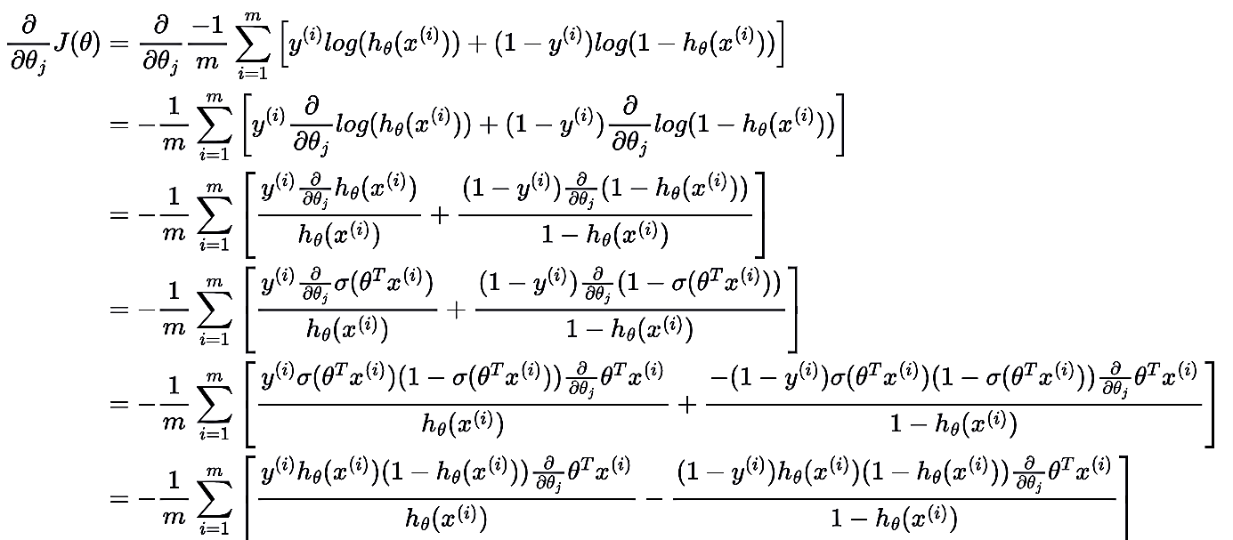
Deriving the Gradient Descent formula for Logistic Regression
Now we are ready to find out the partial derivative:

Slide 17
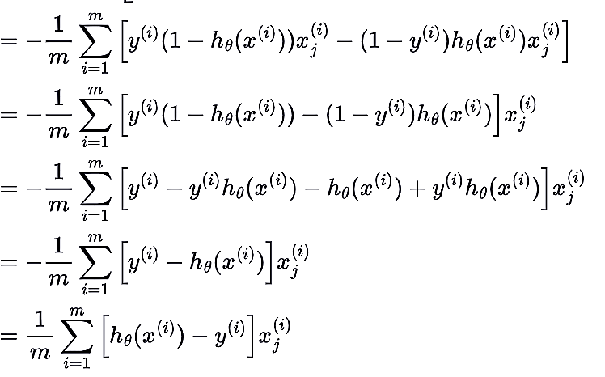
Deriving the Gradient Descent formula for Logistic Regression

Slide 18

Derivation of Cost Function
Hence the derivative of our cost function is:

Slide 19

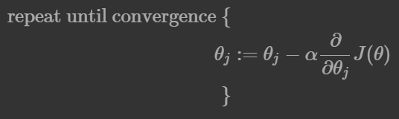
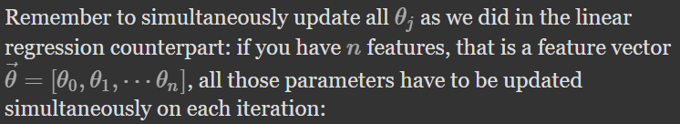
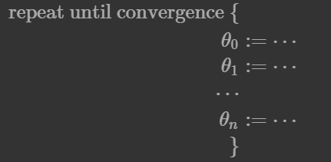
Derivation of Cost Function
It's now time to find the best values for θs parameters in the cost function,
To minimize the cost function we have to run the gradient descent function on each parameter:

Slide 20
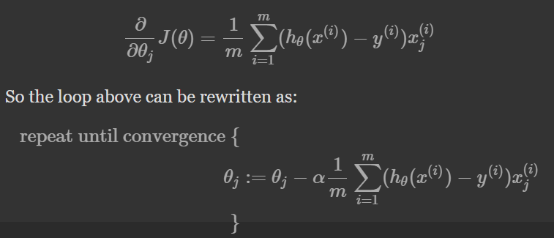
Derivation of Cost Function
Now since we have our derivative of the cost function, we can write our gradient descent algorithm as:
If the slope is negative (downward slope) then our gradient descent will add some value to our new value of the parameter directing it towards the minimum point of the convex curve. Whereas if the slope is positive (upward slope) the gradient descent will minus some value to direct it towards the minimum point.

Slide 21
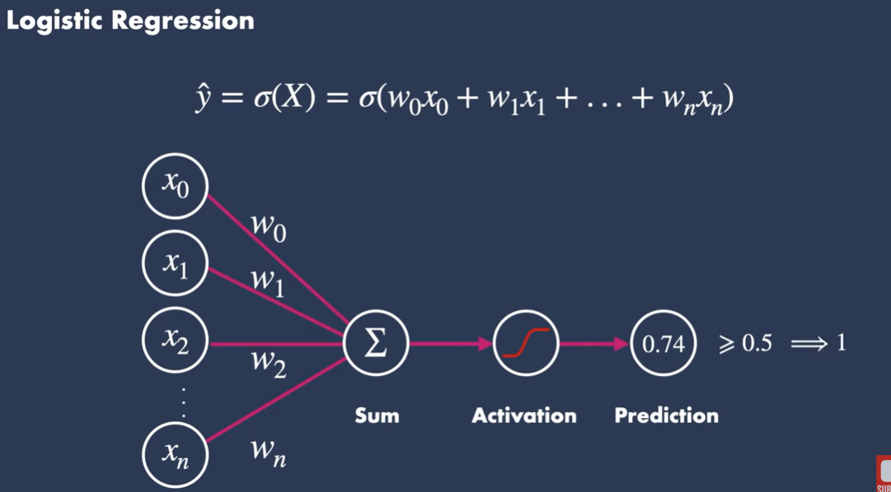

Making Prediction
Suppose we have two possible outcomes, true and false, and have set the threshold as 0.5. A probability less than 0.5 would be mapped to the outcome false, and a probability greater than or equal to 0.5 would be mapped to the outcome true.

Slide 22
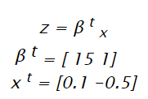

Making Prediction
Suppose, a regression model is fit using some training data to obtain β and x represents the input features:
The probability of z being mapped to 1 is given by the equation:

Slide 23
Making Prediction
Let’s say we have a model that can predict whether a person is male or female based on their height (completely fictitious). Given a height of 150cm is the person male or female.
We have learned the coefficients of b0 = -100 and b1 = 0.6. Using the equation we can calculate the probability of male given a height of 150cm or more formally P(male|height=150). We will use EXP() for e, because that is what you can use if you type this example into your spreadsheet:
y = e^(b0 + b1*X) / (1 + e^(b0 + b1*X))
y = exp(-100 + 0.6*150) / (1 + EXP(-100 + 0.6*X))
y = 0.0000453978687
Or a probability of near zero that the person is a male.
In practice we can use the probabilities directly. Because this is classification and we want a crisp answer, we can snap the probabilities to a binary class value, for example:
0 if p(male) < 0.5
1 if p(male) >= 0.5

Slide 24
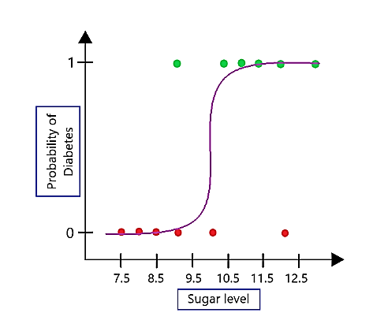
As evident in the plot, sigmoid function is accurately separating the classes for binary classification tasks. Also, it produces continuous values exclusively within the 0 to 1 range, which can be employed for predictive purposes.

Slide 25
Sample Short questions
Why logistic regression cost function is non convex?
The sigmoid function introduces non-linearity, resulting in a non-convex cost function. It has multiple local minima, making optimization challenging, as traditional gradient descent may converge to suboptimal solutions.
What is a cost function in simple terms?
A cost function measures the disparity between predicted values and actual values in a machine learning model. It quantifies how well the model aligns with the ground truth, guiding optimization.
Is the cost function for logistic regression always negative?
No, the cost function for logistic regression is not always negative. It includes terms like -log(h(x)) and -log(1 – h(x)), and the overall value depends on the predicted probabilities and actual labels, yielding positive or negative values.
5.Why only sigmoid function is used in logistic regression?
The sigmoid function maps real-valued predictions to probabilities between 0 and 1, facilitating the interpretation of results as probabilities. Its range and smoothness make it suitable for binary classification, ensuring stable optimization.
Notes:
01622917203 Nazrul

Slide 26
Thank You

